Slide 1


Slide 2
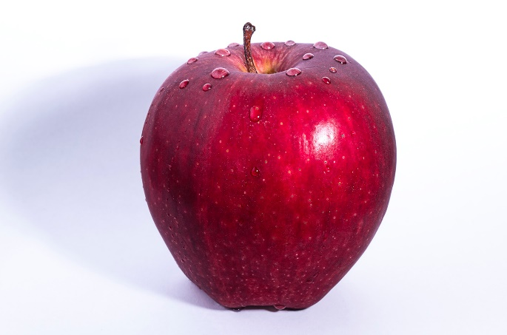
HEALTHY FOOD
HOW CAN FOOD IMPACT
YOUR BODY & MIND?

Slide 3
HEALTHY FOOD
HOW CAN FOOD IMPACT
YOUR BODY & MIND?

Slide 4
What your body needs mostly is…
50%
FRUITS & VEGETABLE

Slide 5
What your body needs mostly is…
50%
FRUITS & VEGETABLE
30%
WHOLE GRAIN

Slide 6

What your body needs mostly is…
50%
FRUITS & VEGETABLE
30%
WHOLE GRAIN
20%
PROTEINS

